Slide 1
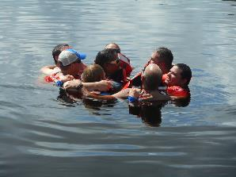
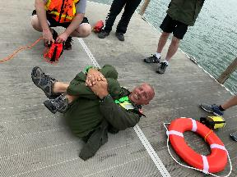
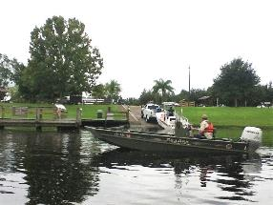
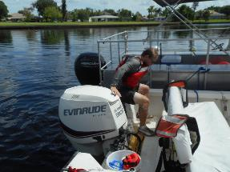
MOTORBOAT TRAINING, TESTING & LICENSING
Presenter:
Title: Required Equipment
Manual - TAB 5
Date:

Slide 2
Required Equipment
Objectives:
Identify the two classes of recreational vessels you are licensing for
Identify and describe the proper use and application of the required safety equipment that are required by Federal and State laws and the US Army Corps of Engineers Safety and Health Requirements Manual (EM 385-1-1) for these vessel classes.

Slide 3
Vessel Classes
CLASS A = vessels less than 16ft (4.9m)
CLASS I = vessels 16ft to less than 26ft (4.9m – 7.9m)
Each class of vessel has minimum equipment requirements established by Federal law. Individual states and the Corps of Engineers also have specific equipment requirements for vessels under their jurisdiction.

Slide 4
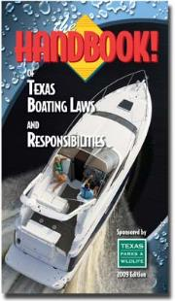
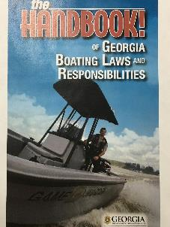
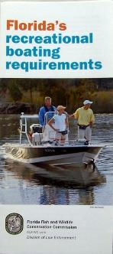
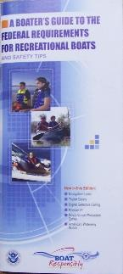
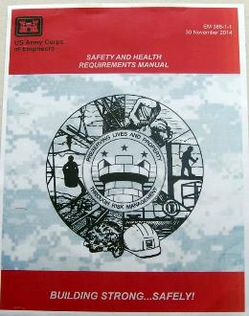
Federal (United States Coast Guard (USCG))
State
U.S. Army Corps of Engineers (EM 385-1-1)

Slide 5
Fire extinguisher requirements on recreational vessels (USCG)
1. Number of approved fire extinguishers depends upon the length and/or construction of the vessel.
2. Fire extinguishers are required on all recreational boats which have compartments and where explosive or flammable gases or vapors can be trapped. The following conditions require a fire extinguisher.
a. Closed compartments where portable fuel tanks may be stored.
b. Unsealed double-bottoms not completely filled with flotation material.
c. Closed living spaces.
d. Closed stowage compartment in which combustible or flammable materials are stowed.
e. Permanently installed fuel tanks. A tank is permanent if it is secured in any way. If weight or location is such as to likely prevent someone from removing it in an emergency, the tank is considered permanent.

Slide 6
Fire Class & Fire Extinguisher Type
Fuel Source | Class of Fire | Type of Extinguisher (Extinguishing Agent)
Ordinary combustibles (e.g. trash, wood, paper, cloth) | A | Water; chemical foam; dry chemical
Flammable liquids (e.g. oils, grease, tar, gasoline, paints, thinners) | B | Carbon dioxide (CO2); halon; dry chemical; aqueous film forming foam (AFFF)
Electricity (e.g. live electrical equipment) | C | CO2; halon; dry chemical
Combustible metals (e.g. magnesium, titanium) | D | Dry powder (suitable for the specific combustible metal involved)

Slide 7
Federal and State
USCG Approved, label will state similar to:
“Marine Type USCG
Type B:C Size I
Approval Number 162.028/EX2764
Valid Only With Bracket 817”
Must be mounted in their specific marine type bracket in a readily accessible position
Inspect monthly, replace as necessary

Slide 8
USCG PFD Requirements*
Class A Boats:
On boats less than 16 feet in length there must be at least one WEARABLE PFD (Type I, II, III, or V) readily accessible for each person on board.
Class I Boats:
On boats 16 feet in length or longer there must be at least one WEARBLE PFD for each person on board plus at least one THROWABLE PFD (Type IV) immediately available.
On any boat underway a child under the age of 13 must wear an appropriate USCG approved PFD unless they are below decks or in an enclosed cabin**. Georgia law is also under the age of 13.
*33 CFR Part 175 – established 2014
** Individual State statutes for age requirement preempt USCG requirement

Slide 9
USCG PFD Requirements
Legibly Marked with its USCG Approval Number
Good & Serviceable Condition
Appropriate Size and type for the Intended Wearer
Properly stowed

Slide 10
PFD Conditions cont’d
Adult (persons weighing 90 pounds or more) and capable of supporting a minimum of 25 pounds of buoyancy in fresh water for 48 hours
Child (persons weighing less than 90 pounds) and capable of supporting a minimum of 16.5 pounds of buoyancy in fresh water for 48 hours
Shall support the wearer in the water in an upright or slightly backward position, and shall provide support to the head so that the face of an unconscious or exhausted person is held above the water
Shall be capable of turning the wearer, upon entering the water, to a safe flotation position as described above

Slide 11
STATISTICS
YEAR | TOTAL FATALITIES | % OF FATALITIES THAT DROWNED | % OF FATALITIES THAT DROWNED WHO WERE NOT WEARING A PFD
2009 | 683 | 75% | 84%
2010 | 639 | 75% | 88%
2011 | 697 | 70% | 84%
2012 | 651 | 71% | 85%
2013 | 560 | 77% | 84%
2014 | 610 | 78% | 84%
2015 2016 2017 2018 | 626 701 658 633 | 76% 80% 76% 77% | 85% 83% 84.5% 84%
Where length was known, 80% of drownings were on boats less than 21 feet in length and where instruction was known, 74% of the operators did not receive boating safety instruction

Slide 12
PFD Buoyancy
How can a WEARABLE PFD with 25 pounds of buoyancy hold up a two hundred fifty pound person in the water?
You have to do the math!
Approximately 80% of the body is water. Water in the body has no weight in water.
250 lbs. X 80% = 200 lbs.
250 lbs. - 200 lbs. = 50 lbs.
So now we are down to having to support only 50 pounds. But the PFD only has a buoyancy rating of 25 lbs. How can it hold up 50 lbs?
On average our bodies also have 15% fat and fat is lighter than water.
250 lbs. X 15% = 37.5 lbs.
50 lbs. – 37.5 lbs. = 12.5 lbs.
Now you can see that the average 250 pound person weighs about 12.5 pounds in water. The 25 lbs. of buoyancy in the PFD is more than enough to keep the person afloat.

Slide 13
PFD Accessories
Knife
Signal mirror
Whistle
Flashlight
Waterproof meteor flares
Strobe light
Anything that will help people find you, keep you alive, keep you afloat.

Slide 14
Visual Distress Signals (VDS) Requirements
Pyrotechnic – 3 day and 3 night devices or 3 combination day/night
Non-pyrotechnic – 1 day and 1 night device
Any combination so long as the minimum number per type is carried (Expired signals may be carried as extra equipment but are not counted toward meeting the VDS requirement)
Vessel Requirements
Class A – night signals when operating between sunset and sunrise on any waters and on required waters
Class I – day/night signals at all times on required waters and night signals when operating any waters between sunset and sunrise
Required waters: Coastal waters, the Great Lakes, territorial seas, and those waters connected directly to them, up to a point where a body of water is less than two miles wide.

Slide 15
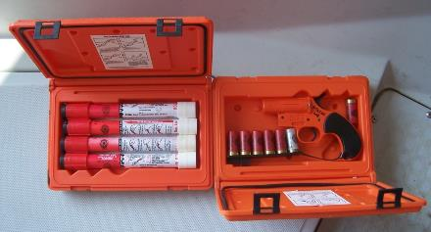
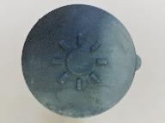
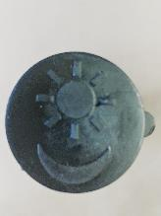
Pyrotechnic VDS
Must be Coast Guard approved
In serviceable condition
Readily accessible
Flare Pistols, Hand-held Red Flares and Orange Smoke Flares

Slide 16
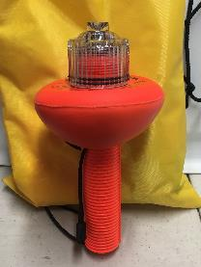
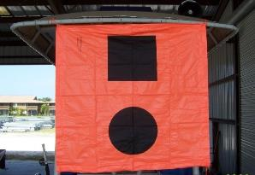
Non-Pyrotechnic VDS
Must be Coast Guard approved
In serviceable condition
Readily accessible
Orange Distress Flag and an Electric Distress Light

Slide 17
Sound Producing Device
Class A and Class I Vessels * – some means of making an efficient sound signal
(4-6 second blast) audible for ½ mile
*Not required on Georgia
State waters but highly
recommended

Slide 18
Navigation Lights
Required to be displayed from sunset to sunrise and in restricted visibility
Tell other boaters
Type of vessel you are
Size of vessel you are
Direction (movement) of your vessel
Any Work you are performing

Slide 19
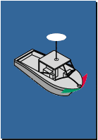
Navigation Lights
Power-driven - Classes A and I
Must display
Masthead light (225 , 2 miles)
Stern light (135 , 2 miles)
Red and Green sidelights (112.5 ,1 mile)
OR
May Display
360 degree all around white light (2 miles)
Red and green sidelights (112.5 , 1 mile)

Slide 20
Anchored Vessels
Night – All around white light visible for two miles
Exception, USCG)– Vessels less than 23 ft/7 m are not required to display anchor lights unless anchored in or near a narrow channel, fairway or anchorage, or where other vessels normally navigate.
Georgia law– all vessels moored or anchored outside a designated mooring area during hours of darkness must display this light

Slide 21
Diver Down Flag
Diver Down Flag
Red & White Protect Divers/Snorkelers
15 inches x 15 inches (GA)
Safety Zone - 100 Feet (GA)
Required on State waters
Alpha Dive Flag
White & Blue Protect Vessel
No Less Than 1 meter in height
Required on Federally controlled waters
Both flags must be displayed rigidly

Slide 22
Additional Safety and Emergency Equipment
Anchor and line
Tow line and bridle
Marine Radio
Mooring lines
Boat hook
Bilge pump(s)
Rescue line
Paddle
Compass
Tool kit
First aid kit
Navigation kit
GPS
Nautical Chart
Hand-held light
Additional PFD’s
In the world according to Art, these would be required equipment
Notes:
In the world according to Art, these would be required equipment

Slide 23
Personnel Protective Equipment (29 CFR 1910.132)
EYE PROTECTION
Clear/tinted, impact rated
FOOTWEAR
Non-skid/scuffing, cushioning, insulation
HEARING PROTECTION
Ear muffs/plugs
U.V. RAY PROTECTION
Sun block, clothing

Slide 24
Questions to this Point?

Slide 25
Corps of Engineer Reqmts: Government operators shall be licensed & certified in accordance with ER 385-1-91
EM 385-1-1
01A.15.a. An AHA shall be prepared and documented as warranted by the hazards associated with the activity
03.B.01 b. First Aid Kit - TYPE III, 16 unit (reference Table 3-1 for contents)
05.J.01 Inherently buoyant Type III, Type V work vests, or better USCG-approved personal flotation devices (PFDs) shall be provided and properly worn (zipped, tied, latched, etc., in closed fashion) by all persons in the following circumstances:
a. On floating pipelines, pontoons, rafts, or stages;
b. On structures or equipment extending over or next to water except where guardrails, personal fall protection system, or safety nets are provided for employees;
c. Working alone at night where there are drowning hazards, regardless of other safeguards provided;
d. In skiffs, small boats, or launches, unless in an enclosed cabin or cockpit; or
e. Whenever there is a drowning hazard.

Slide 26
05.J.02 Automatic-Inflatable PFD’s Type V or better, USCG approved for commercial use, may be worn by workers in lieu of inherently buoyant PFD’s (see conditions 05.J.01 a-e above) provided the following criteria are met:
Over 16 years old and weigh 90 lbs or more.
An Activity Hazard Analysis (AHA) shall be developed and used to select the most appropriate PFD for the activity
PFD’s must be inspected, maintained…per manufacturer’s instructions. PFD’s for construction, maintenance, hot work must be designed for that activity. The standard commercial auto-inflatable PFD does not meet these requirements
Provide minimum 30 lbs. of buoyancy & have a status indicator window
Personal shall be trained in the use, maintenance, restrictions, care, storage, inspection, and post-deployment procedures per manufacturer’s instructions.
In water testing is required for all first time users so that wearers become familiar with the feel and performance of the PFD
Must be worn

Slide 27
05.J.03 All wearable PFD’s shall be of an international orange (or orange/red) or ANSI 107 yellow green color.
a. Each inherently buoyant PFD shall have at least 31 sq. in. (200 sq. cm.) of retro-reflective material attached to its front side and at least 31 sq. in. (200 sq. cm.) on its back side per USCG requirements (46 CFR Part 25.25-15).
b. Each auto-inflatable PFD shall have at least 31 sq. in. (200 sq. cm.) of retro-reflective material attached to its front side and at least 31 sq. in. (200 sq. cm.) on its bladder, to be visible when deployed (with the exception of Work Vests which are allowed to have a total of 31 sq. in. front and back combined)

Slide 28
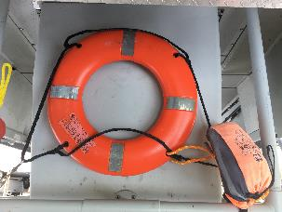
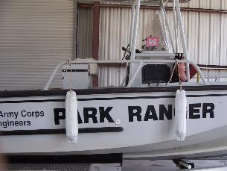
05.J.04 Each PFD shall be equipped with a USCG-approved automatically activated light. Lights are not required for PFDs on projects performed exclusively during daylight hours.
05.J.06 d. Ring Buoys (min 20” diameter) shall be USCG-approved & have at least 90 ft. of 3/8 in. solid braid polypropylene, or equivalent, attached. Throw bags and TYPE IV cushions may be used in addition to ring buoys. Ring buoys and line shall be inspected at a minimum of every six months and stored in such a manner to allow immediate deployment and be protected from degradation from weather and sunlight
19.A.05 a. Fenders shall be provided to prevent damage and sparking and to provide safe areas for workers exposed to pinching situations

Slide 29
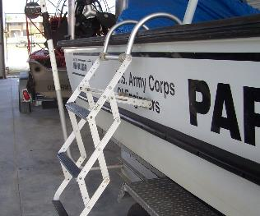
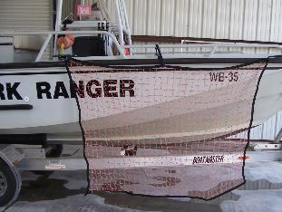
19.A.05 c. Signal Devices (lights, sound devices, VDS, etc.) shall be provided on all vessels to give signals required by the navigation rules applicable to the waters on which the vessel is operated on.
19.B.04 a.
At least one portable or permanent ladder of sufficient length to allow a person to self rescue by boarding the ladder from the water
Other methods or means designed to assist in the rescue of an incapacitated person overboard

Slide 30
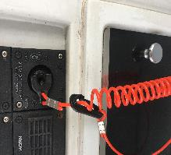
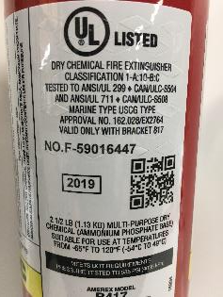
19.F.02 d. All open cabin launches or motorboats shall be equipped with “kill (dead man) switches”.
CESAD-PDO Policy Memorandum 385-18-1 dated 28 May 2018, requires testing of kill switch, operator tethered to kill switch via lanyard and spare lanyard be kept on motorboats
19.F.03 a. The minimum number and rating of fire extinguisher that shall be carried on Class A and Class I motorboats: One - 1A:10BC
This extinguisher contains agents equivalent to 1.25 gallons of water for a Class A fire, extinguish 10 square feet of a Class B fire and
can be used on a Class C fire
19.F.03 b. All motorboats having gasoline or liquid petroleum gas in cabins, compartments or confined spaces shall be equipped with an automatic CO2 fire extinguishing system
Notes:
1A = 1.25 gallons of water
10B = 10 square feet
C = no numerical value, agents in extinguisher are non-conductive and can extinguish a Class C fire

Slide 31
19.F.04 Float Plans shall be prepared by the operator when engaged in surveying, patrolling or inspection activities that are remote and expected to take longer than four hours or when travelling alone. The plan shall be filed with the operators supervisor and at a minimum contain the following:
Vessel information
Personnel on board
Activity to be performed
Expected departure, route and time of return
Means of communication

Slide 32
19.F.05 All Corps of Engineers motorboat operators shall complete and document the following training:
a. A boating safety course meeting the criteria of the USCG Auxiliary, National Association of State Boating Law Administrators (NASBLA), or equivalent; and
b. Motorboat handling training, based on the types of boats they will operate, provided by qualified instructors (in-house or other). Operators must pass a written and operational test.
c. Current USCG licensed personnel are exempt from the boating safety training, but they shall complete the written exam and operational test;
d. Government employees shall complete a USACE-approved 24-hour initial boating safety course and 8-hour refresher as prescribed in ER 385-1-91. Both initial and refresher courses require the 100 yard swim with PFD and self-rescue

Slide 33
REVIEW
What are the two vessel classes and associated lengths we are licensing for?
Name the four fire classes and the materials they are comprised of?
What is the weight to determine if a wearable PFD is classified as an adult or child PFD?
All-around white lights must be visible for what distance?
How can navigation lights be displayed on Class A and Class I vessels?
How long is an efficient sound signal?
What is the minimum number of pyrotechnic VDS required?
What is the COE requirement for fire extinguishers?
What is the COE age and weight to be able to wear an auto-inflatable PFD?
What is the minimum buoyancy requirement for a COE auto inflatable PFD?
The COE requires what type of first aid kit?
Name five other COE equipment requirements besides first aid kit, PFD’s or fire extinguisher?
Notes:
Ladder, fenders, float plan, means to rescue incapacitated person, kill switch, throw ring and 90’ line

